Slide 1
AGGREGATING DATA USING GROUP BY CLAUSE

Slide 2
Creating Groups of Data: The GROUP BY Clause Syntax
SELECT column, group_function(column)
FROM table
[WHERE condition]
[GROUP BY group_by_expression]
[ORDER BY column];
Divide rows in a table into smaller groups by using the
GROUP BY clause.
Notes:
The GROUP BY Clause
You can use the GROUP BY clause to divide the rows in a table into groups. You can then use the group functions to return summary information for each group.
In the syntax:
group_by_expression specifies columns whose values determine the basis for grouping rows
Guidelines
If you include a group function in a SELECT clause, you cannot select individual results as well, unless the individual column appears in the GROUP BY clause. You receive an error message if you fail to include the column list in the GROUP BY clause.
Using a WHERE clause, you can exclude rows before dividing them into groups.
You must include the columns in the GROUP BY clause.
You cannot use a column alias in the GROUP BY clause.
By default, rows are sorted by ascending order of the columns included in the GROUP BY list. You can override this by using the ORDER BY clause.

Slide 3
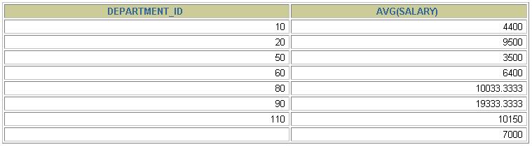
Using the GROUP BY Clause
All columns in the SELECT list that are not in group
functions must be in the GROUP BY clause.
The GROUP BY clause specifies how the rows should be
grouped. The rows are being grouped by department
number
SELECT department_id, AVG(salary)
FROM employees
GROUP BY department_id ;
Notes:
The GROUP BY Clause (continued)
When using the GROUP BY clause, make sure that all columns in the SELECT list that are not group functions are included in the GROUP BY clause. The example on the slide displays the department number and the average salary for each department. Here is how this SELECT statement, containing a GROUP BY clause, is evaluated:
The SELECT clause specifies the columns to be retrieved:
Department number column in the EMPLOYEES table
The average of all the salaries in the group you specified in the GROUP BY clause
The FROM clause specifies the tables that the database must access: the EMPLOYEES table.
The WHERE clause specifies the rows to be retrieved. Since there is no WHERE clause, all rows are retrieved by default.
The GROUP BY clause specifies how the rows should be grouped. The rows are being grouped by department number, so the AVG function that is being applied to the salary column will calculate the average salary for each department.
Instructor Note
Group results are sorted implicitly, on the grouping column. You can use ORDER BY to specify a different sort order, remembering to use only group functions, or the grouping column.

Slide 4
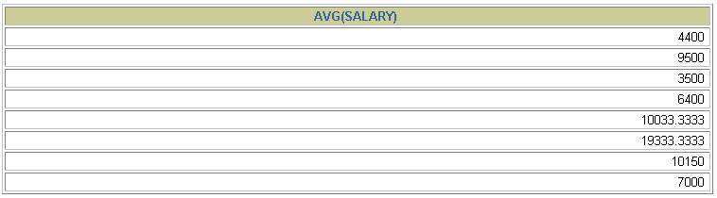
Using the GROUP BY Clause
The GROUP BY column does not have to be in the
SELECT list.
SELECT AVG(salary)
FROM employees
GROUP BY department_id ;
Notes:
The GROUP BY Clause (continued)
The GROUP BY column does not have to be in the SELECT clause. For example, the SELECT statement on the slide displays the average salaries for each department without displaying the respective department numbers. Without the department numbers, however, the results do not look meaningful.
You can use the group function in the ORDER BY clause.
SELECT department_id, AVG(salary)
FROM employees
GROUP BY department_id
ORDER BY AVG(salary);
Instructor Note
Demonstrate the query with and without the DEPARTMENT_ID column in the SELECT statement.
…

Slide 5
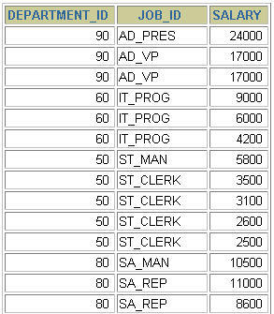
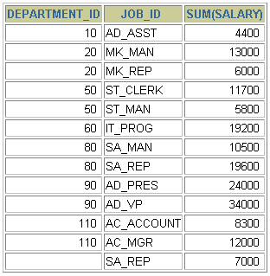

Grouping by More Than One Column
EMPLOYEES
“Add up the
salaries in
the EMPLOYEES
table for each job,
grouped by
department.
…
Notes:
Groups within Groups
Sometimes you need to see results for groups within groups. The slide shows a report that displays the total salary being paid to each job title, within each department.
The EMPLOYEES table is grouped first by department number and, within that grouping, by job title. For example, the four stock clerks in department 50 are grouped together and a single result (total salary) is produced for all stock clerks within the group.
Instructor Note
Demo: 5_order1.sql, 5_order2.sql
Purpose: To illustrate ordering columns that are grouped by DEPARTMENT_ID first and ordering columns that are grouped by JOB_ID first.

Slide 6
Using the GROUP BY Clause on Multiple Columns
SELECT department_id dept_id, job_id, SUM(salary)
FROM employees
GROUP BY department_id, job_id ;
The GROUP BY clause specifies how you must group the rows:
First, the rows are grouped by department number.
Second, within the department number groups, the rows are grouped by job ID.
The SUM function is being applied to the salary column for all job IDs within each department number group
Notes:
Groups within Groups (continued)
You can return summary results for groups and subgroups by listing more than one GROUP BY column. You can determine the default sort order of the results by the order of the columns in the GROUP BY clause. Here is how the SELECT statement on the slide, containing a GROUP BY clause, is evaluated:
The SELECT clause specifies the column to be retrieved:
Department number in the EMPLOYEES table
Job ID in the EMPLOYEES table
The sum of all the salaries in the group that you specified in the GROUP BY clause
The FROM clause specifies the tables that the database must access: the EMPLOYEES table.
The GROUP BY clause specifies how you must group the rows:
First, the rows are grouped by department number.
Second, within the department number groups, the rows are grouped by job ID.
So the SUM function is being applied to the salary column for all job IDs within each department number group.

Slide 7
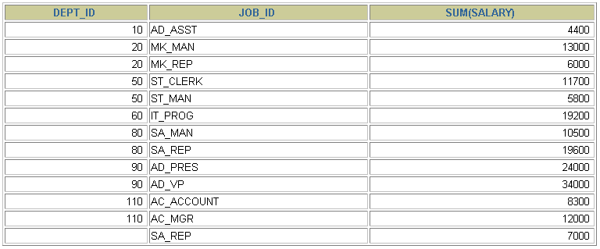
Using the GROUP BY Clause on Multiple Columns
SELECT department_id dept_id, job_id, SUM(salary)
FROM employees
GROUP BY department_id, job_id ;
Notes:
Groups within Groups (continued)
You can return summary results for groups and subgroups by listing more than one GROUP BY column. You can determine the default sort order of the results by the order of the columns in the GROUP BY clause. Here is how the SELECT statement on the slide, containing a GROUP BY clause, is evaluated:
The SELECT clause specifies the column to be retrieved:
Department number in the EMPLOYEES table
Job ID in the EMPLOYEES table
The sum of all the salaries in the group that you specified in the GROUP BY clause
The FROM clause specifies the tables that the database must access: the EMPLOYEES table.
The GROUP BY clause specifies how you must group the rows:
First, the rows are grouped by department number.
Second, within the department number groups, the rows are grouped by job ID.
So the SUM function is being applied to the salary column for all job IDs within each department number group.

Slide 8

Illegal Queries Using Group Functions
Any column or expression in the SELECT list that is
not an aggregate function must be in the GROUP BY
clause.
SELECT department_id, COUNT(last_name)
FROM employees;
SELECT department_id, COUNT(last_name)
*
ERROR at line 1:
ORA-00937: not a single-group group function
Column missing in the GROUP BY clause
Notes:
Illegal Queries Using Group Functions
Whenever you use a mixture of individual items (DEPARTMENT_ID) and group functions (COUNT) in the same SELECT statement, you must include a GROUP BY clause that specifies the individual items (in this case, DEPARTMENT_ID). If the GROUP BY clause is missing, then the error message “not a single-group group function” appears and an asterisk (*) points to the offending column. You can correct the error on the slide by adding the GROUP BY clause.
SELECT department_id, count(last_name)
FROM employees
GROUP BY department_id;
Any column or expression in the SELECT list that is not an aggregate function must be in the GROUP BY clause.
Instructor Note
Demo: 5_error.sql
Purpose: To illustrate executing a SELECT statement with no GROUP BY clause
…

Slide 9
CORRECTION!
Any column or expression in the SELECT list that is
not an aggregate function must be in the GROUP BY
clause.
Whenever you use a mixture of individual items (DEPARTMENT_ID) and group functions (COUNT) in the same SELECT statement, you must include a GROUP BY clause that specifies the individual items (in this case, DEPARTMENT_ID).
SELECT department_id, COUNT(last_name)
FROM employees
GROUP BY department_id
Notes:
Illegal Queries Using Group Functions
Whenever you use a mixture of individual items (DEPARTMENT_ID) and group functions (COUNT) in the same SELECT statement, you must include a GROUP BY clause that specifies the individual items (in this case, DEPARTMENT_ID). If the GROUP BY clause is missing, then the error message “not a single-group group function” appears and an asterisk (*) points to the offending column. You can correct the error on the slide by adding the GROUP BY clause.
SELECT department_id, count(last_name)
FROM employees
GROUP BY department_id;
Any column or expression in the SELECT list that is not an aggregate function must be in the GROUP BY clause.
Instructor Note
Demo: 5_error.sql
Purpose: To illustrate executing a SELECT statement with no GROUP BY clause
…

Slide 10
Illegal Queries Using Group Functions
You cannot use the WHERE clause to restrict groups.
You use the HAVING clause to restrict groups.
You cannot use group functions in the WHERE clause.
SELECT department_id, AVG(salary)
FROM employees
WHERE AVG(salary) > 8000
GROUP BY department_id;
WHERE AVG(salary) > 8000
*
ERROR at line 3:
ORA-00934: group function is not allowed here
Cannot use the WHERE clause to restrict groups
Notes:
Illegal Queries Using Group Functions (continued)
The WHERE clause cannot be used to restrict groups. The SELECT statement on the slide results in an error because it uses the WHERE clause to restrict the display of average salaries of those departments that have an average salary greater than $8,000.
You can correct the slide error by using the HAVING clause to restrict groups.
SELECT department_id, AVG(salary)
FROM employees
HAVING AVG(salary) > 8000
GROUP BY department_id;

Slide 11
CORRECTION!
You cannot use the WHERE clause to restrict groups.
You use the HAVING clause to restrict groups.
You cannot use group functions in the WHERE clause.
SELECT department_id, AVG(salary)
FROM employees
GROUP BY department_id;
HAVING AVG(salary) > 8000
Notes:
Illegal Queries Using Group Functions (continued)
The WHERE clause cannot be used to restrict groups. The SELECT statement on the slide results in an error because it uses the WHERE clause to restrict the display of average salaries of those departments that have an average salary greater than $8,000.
You can correct the slide error by using the HAVING clause to restrict groups.
SELECT department_id, AVG(salary)
FROM employees
HAVING AVG(salary) > 8000
GROUP BY department_id;

Slide 12
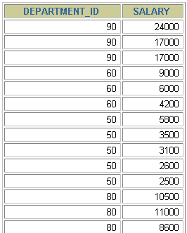
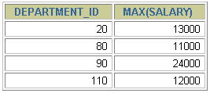

Excluding Group Results
EMPLOYEES
find the maximum salary of each department, but show only the departments that have a maximum salary of more than $10,000
The maximum salary per department
when it is
greater than $10,000
…
Notes:
Restricting Group Results
In the same way that you use the WHERE clause to restrict the rows that you select, you use the HAVING clause to restrict groups. To find the maximum salary of each department, but show only the departments that have a maximum salary of more than $10,000, you need to do the following:
1. Find the average salary for each department by grouping by department number.
2. Restrict the groups to those departments with a maximum salary greater than $10,000.

Slide 13
Excluding Group Results: The HAVING Clause
Use the HAVING clause to restrict groups:
1. Rows are grouped.
2. The group function is applied.
3. Groups matching the HAVING clause are displayed.
SELECT column, group_function
FROM table
[WHERE condition]
[GROUP BY group_by_expression]
[HAVING group_condition]
[ORDER BY column];
Notes:
The HAVING Clause
You use the HAVING clause to specify which groups are to be displayed, and thus, you further restrict the groups on the basis of aggregate information.
In the syntax:
group_condition restricts the groups of rows returned to those groups for which the specified condition is true
The Oracle server performs the following steps when you use the HAVING clause:
1. Rows are grouped.
2. The group function is applied to the group.
3. The groups that match the criteria in the HAVING clause are displayed.
The HAVING clause can precede the GROUP BY clause, but it is recommended that you place the GROUP BY clause first because that is more logical. Groups are formed and group functions are calculated before the HAVING clause is applied to the groups in the SELECT list.
Instructor Note
The Oracle server evaluates the clauses in the following order:
If the statement contains a WHERE clause, the server establishes the candidate rows.
The server identifies the groups specified in the GROUP BY clause.
The HAVING clause further restricts result groups that do not meet the group criteria in the HAVING clause.

Slide 14

Using the HAVING Clause
Find the maximum salary of each department, but show only the departments that have a maximum salary of more than $10,000
SELECT department_id, MAX(salary)
FROM employees
GROUP BY department_id
HAVING MAX(salary)>10000 ;
Notes:
The HAVING Clause (continued)
The slide example displays department numbers and maximum salaries for those departments whose maximum salary is greater than $10,000.
You can use the GROUP BY clause without using a group function in the SELECT list.
If you restrict rows based on the result of a group function, you must have a GROUP BY clause as well as the HAVING clause.
The following example displays the department numbers and average salaries for those departments whose maximum salary is greater than $10,000:
SELECT department_id, AVG(salary)
FROM employees
GROUP BY department_id
HAVING max(salary)>10000;

Slide 15

Using the HAVING Clause
SELECT job_id, SUM(salary) PAYROLL
FROM employees
WHERE job_id NOT LIKE '%REP%'
GROUP BY job_id
HAVING SUM(salary) > 13000
ORDER BY SUM(salary);
Notes:
The HAVING Clause (continued)
The slide example displays the job ID and total monthly salary for each job with a total payroll exceeding $13,000. The example excludes sales representatives and sorts the list by the total monthly salary.
Instructor Note
Demo: 5_job1.sql, 5_job2.sql
Purpose: To illustrate using a WHERE clause to restrict rows by JOB_ID and using a HAVING clause to restrict groups by SUM(SALARY).

Slide 16
Nesting Group Functions
Display the maximum average salary.
SELECT MAX(AVG(salary))
FROM employees
GROUP BY department_id;
Notes:
Nesting Group Functions
Group functions can be nested to a depth of two. The slide example displays the maximum average salary.

Slide 17
Summary
In this lesson, you should have learned how to:
Use the group functions COUNT, MAX, MIN, AVG
Write queries that use the GROUP BY clause
Write queries that use the HAVING clause
SELECT column, group_function(column)
FROM table
[WHERE condition]
[GROUP BY group_by_expression]
[HAVING group_condition]
[ORDER BY column];
Notes:
Summary
Seven group functions are available in SQL:
AVG
COUNT
MAX
MIN
SUM
STDDEV
VARIANCE
You can create subgroups by using the GROUP BY clause. Groups can be excluded using the HAVING clause.
Place the HAVING and GROUP BY clauses after the WHERE clause in a statement. Place the ORDER BY clause last.
The Oracle server evaluates the clauses in the following order:
1. If the statement contains a WHERE clause, the server establishes the candidate rows.
2. The server identifies the groups specified in the GROUP BY clause.
3. The HAVING clause further restricts result groups that do not meet the group criteria in the HAVING clause.

